Slide 1
ANALYSIS OF SSD ARCHITECTURE AND READ/WRITE ON SOLID STATE DRIVE
DRISHTI GOEL
AESHA ALTHNYAN
CATHALINA FONTENELLE
MENG XU

Slide 2






OUTLINE
Recap
Wear Levelling Algorithm
Implementation
Tools and their Results
Simulators
Conclusion

Slide 3
RECAP
SSDs:
Solid-state storage device that uses integrated circuit assemblies as memory to store data persistently.
Target for system designers
Black boxes
Internals are undocumented .. performance characteristics vary across models
Same block device interface as HDDs
But .. behave in a very different way.
Behavior of an SSD depends on undocumented internal features at the hardware level.

Slide 4
WEAR LEVELLING ALGORITHM
keeps track of
The ages of all blocks
A timestamp for each block marking the time in which it was last erased
The average length of time it takes a block to be erased.
The current time.
Using this information:
can identify young blocks that have not been erased for a very long time
Target them for static wear leveling.

Slide 5
WEAR LEVELLING ALGORITHM
Dynamic wear-leveling:
Allow maintaining several free blocks of different ages in each LUN.
Goal: associate hot data with young blocks and cold data with old blocks.
Temperature detection for pages can be done by :
Assuming the pages migrated in static wear-leveling are cold, and everything else is hot
Using information about the temperature of data coming through an open interface from the application.

Slide 6
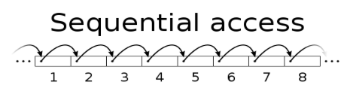
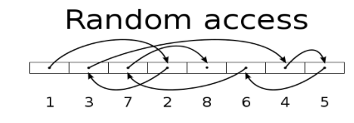
Sequential and Random Access
Sequential
Random
Computer system reads/writes information to the file sequentially.
Starting from the beginning of the file and proceeding step by step.
Computer system can read/write information anywhere in the data file.
Direct Access
Computer knows where the data is stored … goes “directly” and reads the data.
Easier (e.g. Indexing)

Slide 7
IMPLEMENTATION GOAL
•Read Write base parameters
•Cache influence
•Is random write the worst case?
•Does random read have uniform latency?
•Read write interference

Slide 8
TESTING PLATFORM:
We have used the SSD’s present on Heracles Server
Different SSD’s in Heracles Server
Master Node | Compute Node
HGST SN100 1.6TB NVMe 2.5’’ Solid State Drive | 120GB Intel DC S3510 2.5” SATA 6Gbps MLC SSD

Slide 9
BENCHMARK
Label | Bandwidth | IOPS | Latency
Random Read with cache | 37627.67 | 602039 | 0.01
Random Write with cache | 66.46 | 1060 | 33.42
Sequential Read with cache | 38467.49 | 615479 | 0.02
Sequential Write with cache | 86.96 | 1385 | 7.38
Random Read Without cache | 1418.03 | 22682 | 2.82
Random Write without cache | 292.24 | 4669 | 13.69
Sequential Read without cache | 1397.2 | 22357 | 3.27
Sequential Write without cache | 220 | 3529 | 18.17
Observe individual time performances for sequential and random read/writes

Slide 10
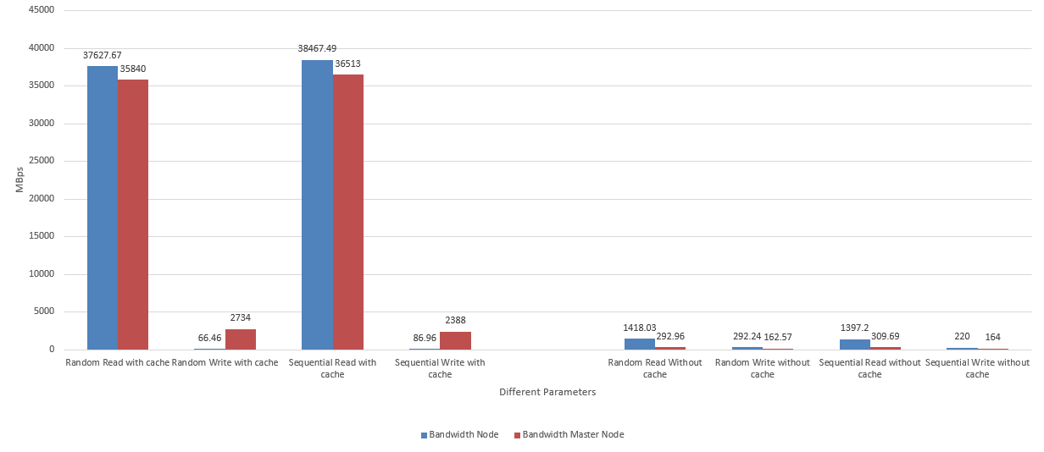
BANDWIDTH
Notes:
Two separate categories - with cache, without cache. With cache, bandwidth is higher especially for read. Bandwidth for write is lower, almost to the level of without cache. Why?

Slide 11
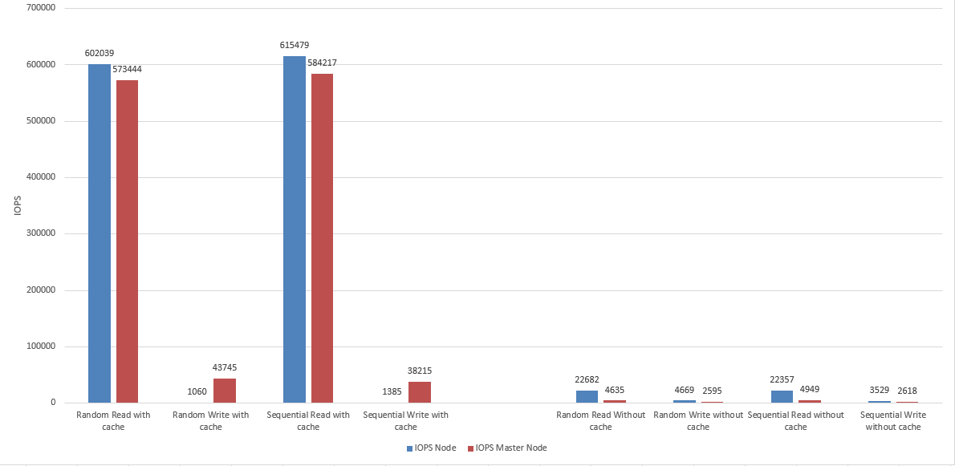
IOPS
Notes:
Similar to bandwidth, the input/output per second read with cache much greater. why

Slide 12
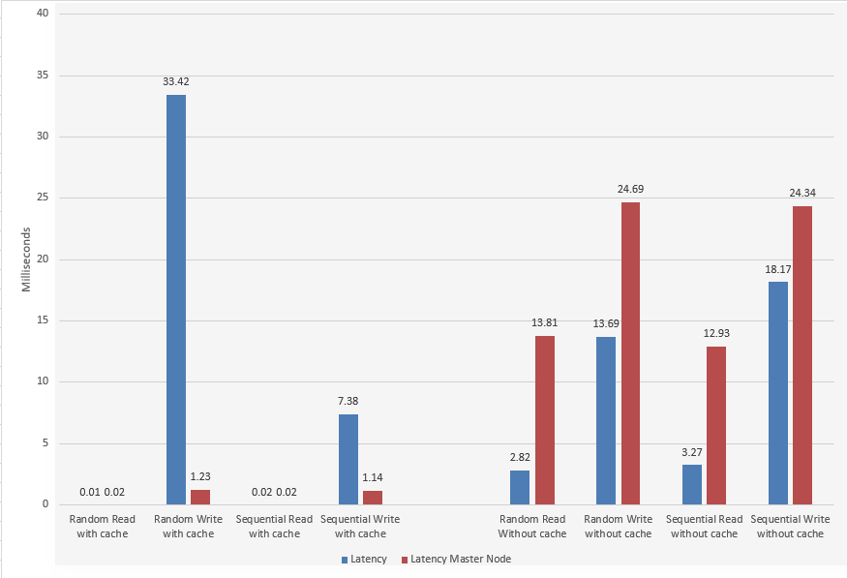
LATENCY
Notes:
latency anomaly, random write with cache much greater than without cache.

Slide 13
INTEL OPEN STORAGE TOOLKIT
Micro-Benchmarks workload.
iSCSCi support
List of configuration parameters to monitor performance.

Slide 14
INTEL OPEN STORAGE --help
Parameters Used:
--file
--direct, --str
--iters
--cap
--wr, --wrnd, --rrnd,--wrsz,--rdsz
--wr_stride, --rd_stride
--warm, --test
Notes:
This is the Open Storage Toolkit from Intel Labs. It contains an iSCSI initiator and target, a SCSI RAM disk, a block-level micro-benchmark, a performance monitor, and I/O tracing and replay. Work with toolkit by manipulating parameters. However, not able to manipulate the Flash translation layer, that algorithm is hidden/ in firmware/proprietary to system. Not able to change the wear-leveling algorithm. FTL maps logical blocks to physical blocks and distribute blocks evenly to account for wear and tear. Warm all blocks to not have hot or cold blocks, to effect performance, in iterations.

Slide 15
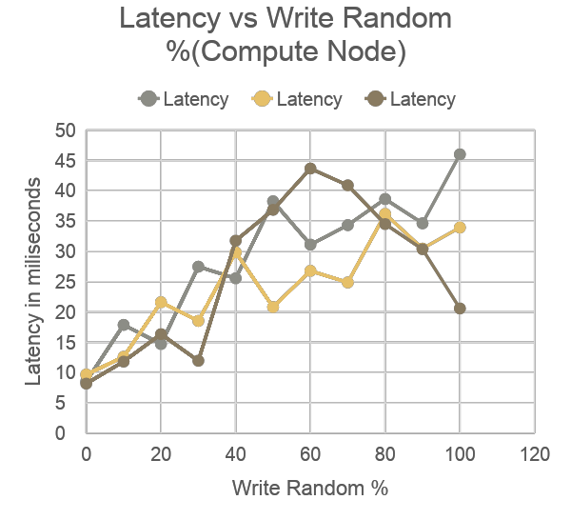
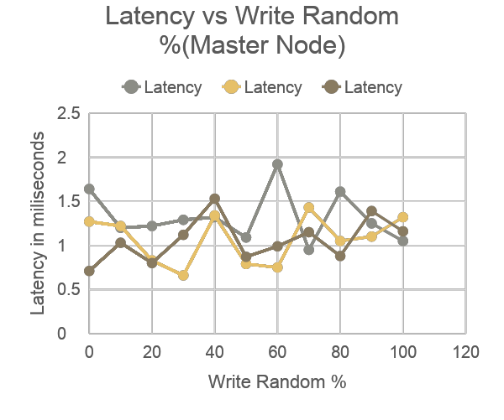
Do Random Writes have worst latency??
Notes:
The below command is used to run workload with 100% write operations and 0% randomness:
./fitness --file test --wr 100 --wrnd 0 --qdep 64 --wrsz 64 --rdsz 64 --wr_stride 4 --rd_stride 4 –rrnd
0 --iter 3
The above command is then repeated with –wrnd values 10,20,30,40,50,60,70,80,90,100 to check for the write operations with the respective random write operations to check if the 100% random is the worst case for SSD performance. The values incremented in the above statement from 10 to 100 specifies the percentage of random writes thereby checking each condition from random writes being 10% to the 100 % random writes thereby testing is the worst case of performance is measured at 100% random writes.
The –iter 3 switch proved results for 3 iterations to evaluate the correctness of the results. The results for this query along with its comparison to the master node SSD performance are as below. This table provides a set of recorder values to monitor the performance based on the latency metrics considering the % of random writes from 10 incrementing towards 100 speculating the result to tend towards a worst case of latency.We can observe that the graphs for 2 out of 3 iteration are tending towards the worst case thereby supporting our theory of the random writes being the worst case of performance. The third iteration however could be an anomaly due to background effects.
We further compare these data to the performance measured at the master node as below:We can observe that the latency on the master node is much lesser than that of the compute node since the SSD on the master is a high level SSD which has much higher performance and expensive. We can further observe that the projection of the iterations on this graph has no incrementation towards the worst case other than a few spikes in data which could be anomalies in data. We could say that the effects of the randomness on the higher end SSD does not effects of the random write on the latency since there could be well defined write management algorithms on the higher end master node as compared to the compute node SSD. Thus, we could observe that the random writes effects the performance on the compute node and is the worst case whereas this does not apply to the high end SSD used for the master node.

Slide 16
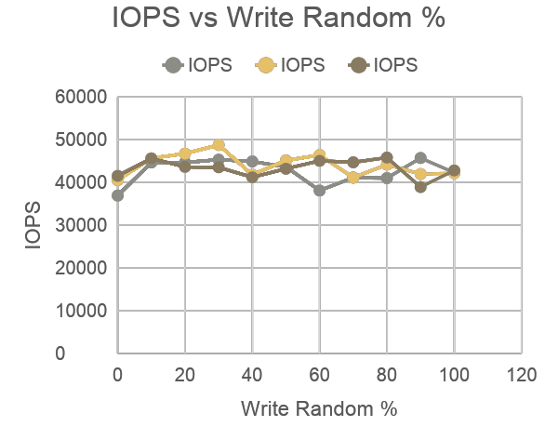
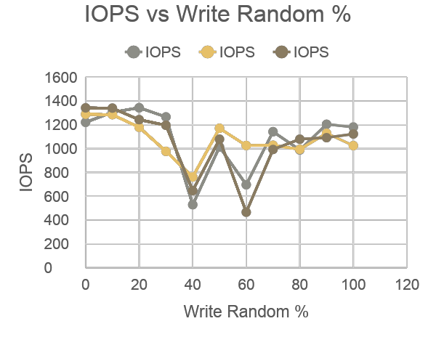
IOPS vs Write Random(%)
Compute Node
Master Node
Notes:
Further collecting the performance data based on the IOPS and bandwidth in Mb/sec metrics for the effects of the random writes on performance. We could observe that the random writes do not affect the bandwidth and the IOPS of the SSD as shown in the graphs below.We can also observe a few anomalies or spikes of variance in data which could be caused due to background operations or different users utilizing the resources.
We could also observe a similar condition on the master node but with a much higher bandwidth and IOPS as observed in the graphs below:

Slide 17
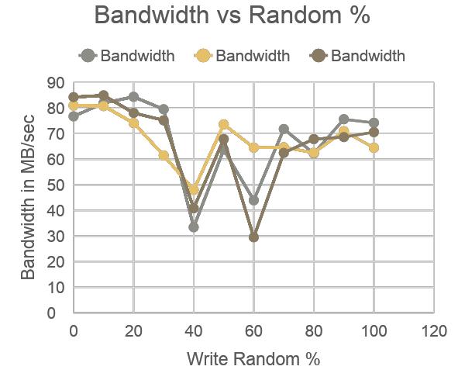
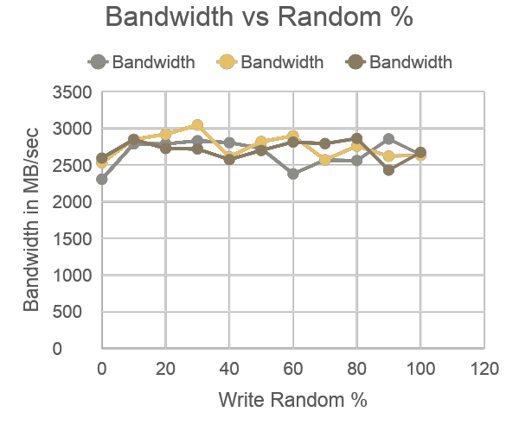
Bandwidth vs Write Random(%)
Compute Node
Master Node
Notes:
Considering all the observations above, we could say that the random writes can be considered as the worst case in the mid-level SSD such as the one used in the compute node. This factor however would not make much of a difference on the high end SSD which have a much better IO management algorithms to work efficiently even at the worst random write conditions.

Slide 18
Read and write Ratio Comparison
case 1 |  |  | case 2 |  |  | case 3 |  |  | case 4
read:write | 50-50 |  | read:write | 50-50 |  | read:write | 50-50 |  | read:write | 50-50
read random | N |  | read random | N |  | read random | Y |  | read random | Y
write random | N |  | write random | Y |  | write random | N |  | write random | Y
case 5 |  |  | case 6 |  |  | case 7 |  |  | case 8
read:write | 75-25 |  | read:write | 75-25 |  | read:write | 25-75 |  | read:write | 25-75
read random | N |  | read random | Y |  | read random | N |  | read random | Y
write random | N |  | write random | Y |  | write random | N |  | write random | Y
Test Case
Notes:
In general, we could say that an I/O workload can be characterized by its access patterns (random or sequential), read/write ratio, request size and concurrency. We have considered the access patters in all the conditions discussed so far and would now be considering the effects of read to write ratio on the performance of the SSD. The performance tests for the read and write interdependencies are monitored in 8 separate cases as explained below:
Case 1:
Command for 50:50 read to write ratio respectively with sequential read and write operations:
./fitness --file test --wr 50 --wrnd 0 –rrnd 0 --qdep 64 --wrsz 64 --rdsz 64 --wr_stride 4 -
rd_stride 4 --iter 3
In this case, we observe the effects on performance considering the IO operations to be 50% read and 50% write operation with both read and write being sequential operations.
Case 2:
Command for 50:50 read to write ratio respectively with sequential read and random write:
./fitness --file test --wr 50 --wrnd 100 –rrnd 0 --qdep 64 --wrsz 64 --rdsz 64 --wr_stride 4 -
rd_stride 4 --iter 3
In this case, we observe the effects on performance considering the IO operations to be 50% read and 50% write operation with sequential read operations and random write operations.
Case 3:
Command for 50:50 read to write ratio respectively with sequential write and random reads:
./fitness --file test --wr 50 --wrnd 0 –rrnd 100 --qdep 64 --wrsz 64 --rdsz 64 --wr_stride 4 -
rd_stride 4 --iter 3
In this case, we observe the effects on performance considering the IO operations to be 50% read and 50% write operation with sequential write operations and random read operations.
Case 4:
Command for 50:50 read to write ratio respectively with random read and write operations:
./fitness --file test --wr 50 --wrnd 100 –rrnd 100 --qdep 64 --wrsz 64 --rdsz 64 --wr_stride 4
-rd_stride 4 --iter 3
In this case, we observe the effects on performance considering the IO operations to be 50% read and 50% write operation with both read and write operations being random.
Case 5:
Command for 75:25 read to write ratio respectively with sequential read and write operations:
./fitness --file test --wr 25 --wrnd 0 –rrnd 0 --qdep 64 --wrsz 64 --rdsz 64 --wr_stride 4 -
rd_stride 4 --iter 3
In this case, we observe the effects on performance considering the IO operations to be 75% read and 25% write operation with both read and write operations being sequential.
Case 6:
Command for 75:25 read to write ratio respectively with random read and write operations:
./fitness --file test --wr 25 --wrnd 100 –rrnd 100 --qdep 64 --wrsz 64 --rdsz 64 --wr_stride 4
-rd_stride 4 --iter 3
In this case, we observe the effects on performance considering the IO operations to be 75% read and 25% write operation with both read and write operations being random
Case 7:
Command for 25:75 read to write ratio respectively with sequential read and write operations:
./fitness --file test --wr 75 --wrnd 0 –rrnd 0 --qdep 64 --wrsz 64 --rdsz 64 --wr_stride 4 -
rd_stride 4 --iter 3
In this case, we observe the effects on performance considering the IO operations to be 25% read and 75% write operation with both read and write operations being sequential.
Case 8:
Command for 25:75 read to write ratio respectively with random read and write operations:
./fitness --file test --wr 75 --wrnd 100 –rrnd 100 --qdep 64 --wrsz 64 --rdsz 64 --wr_stride 4
--rd_stride 4 --iter 3
In this case, we observe the effects on performance considering the IO operations to be 25% read and 75% write operation with both read and write operations being random.
All the above cases can be summarizes using the below tables:

Slide 19
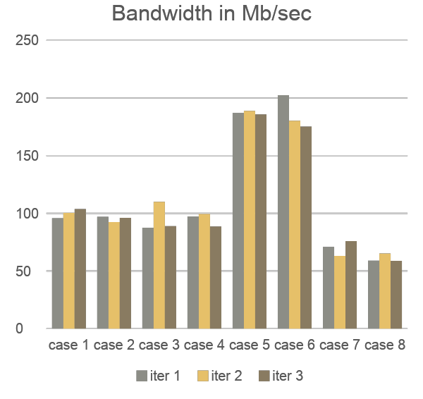
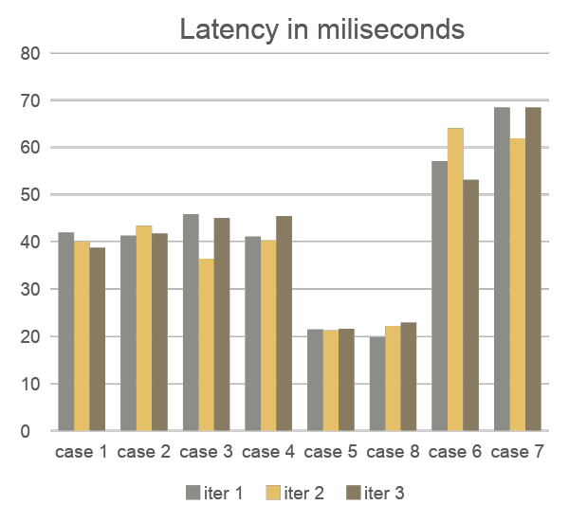
Graph comparisons of read write ratios
Notes:
We can observe that any cases involving a larger number of reads would outperform workloads with larger number of writes since the write operations on the SSD are of very low performance than that of the read operations. An interesting observation here however is that the randomness of the operations does not seem to be playing a larger role on the performance as seen on the above graphs. The graphs for the read write operations with ratio 50:50 with various randomness all seem to be at a proximity to each other thereby reducing the impact of the randomness on the performance of the SSD. The number of read and write operations on the workload seem to affect the overall performance of the SSD greatly.

Slide 20
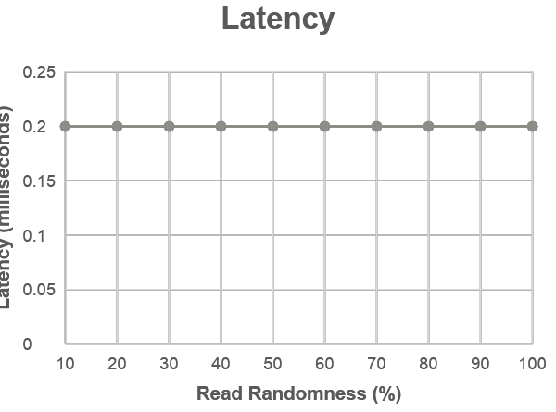
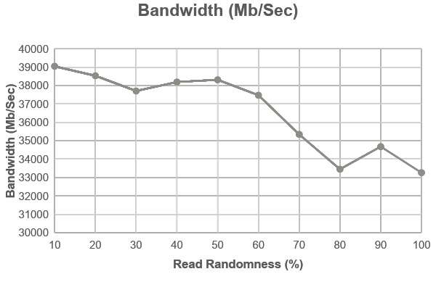
Do reads have uniform latency (Graphs):
Notes:
To check the effects of read randomness on the drive, we run the following command on Heracles Master node server which has the high-end HGST SSD.
./fitness --file readtest --qdep 64 --wrsz 64 --rdsz 64 --rd_stride 4 --wr_stride 4 --wr 0 --rrnd 10
Except the –rrnd10 parameter, we keep everything else the same because we only want to understand the effects of varying the read randomness. We note the values for 10, 20, 30, 40, 50, 60, 70, 80, 90 and 100.
After plotting the values, we plot the graph for read randomness vs latency.After observing the graph, we can see that the latency remains constant if we increase the read randomness. Therefore, we can say that increased read randomness has no effect on the latency.

Slide 21
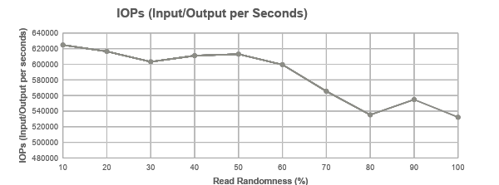
Do reads have uniform latency (Graphs-2):
Notes:
We observe that as the read randomness increases, the bandwidth and IOPs decreases. This can be because the disk must access data from many different locations. Bandwidth and IOPs always go hand in hand and we can expect similar results for both.
Also, we are only sticking to testing the SSD on the master node. We were getting the similar results for the SSD present in the compute node so we focus on the SSD at the master node for this case only.

Slide 22
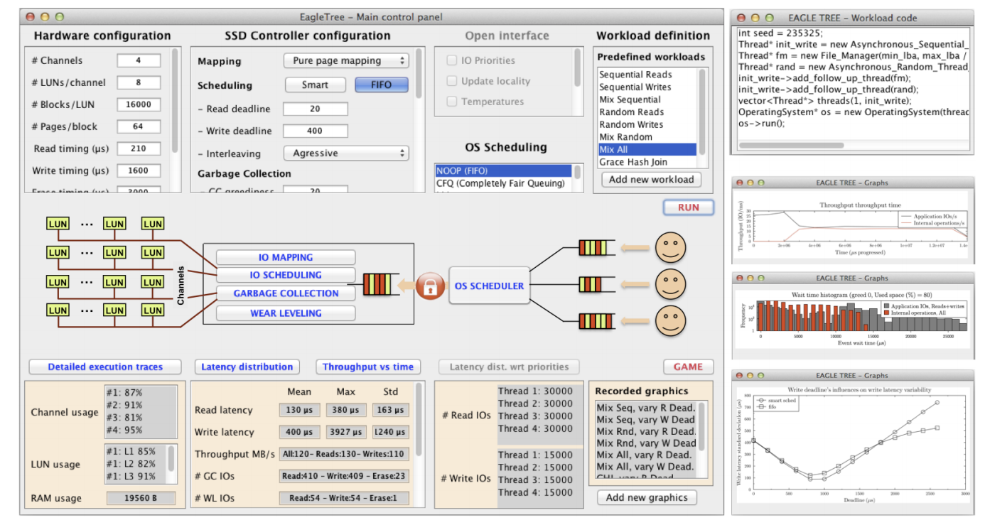
EAGLE TREE SIMULATOR
Notes:
we also try the stuff on another simulator on the eagle tree. here is what it suppose look like, in this simulator is have hardware configuration like block size, page size and so on, also it have some pr defined workloads like and soma other os schedulomng

Slide 23
COMPARISON
 | SMALL | MIDDLE | BETWEEN | LARGE
SSD_size | 4 | 4 | 4 | 8
package_size | 2 | 4 | 2 | 4
plane_size | 1024 | 1024 | 1024 | 1024
block_size | 128 | 128 | 256 | 128
page_size | 4096 | 4096 | 4096 | 4096

Slide 24
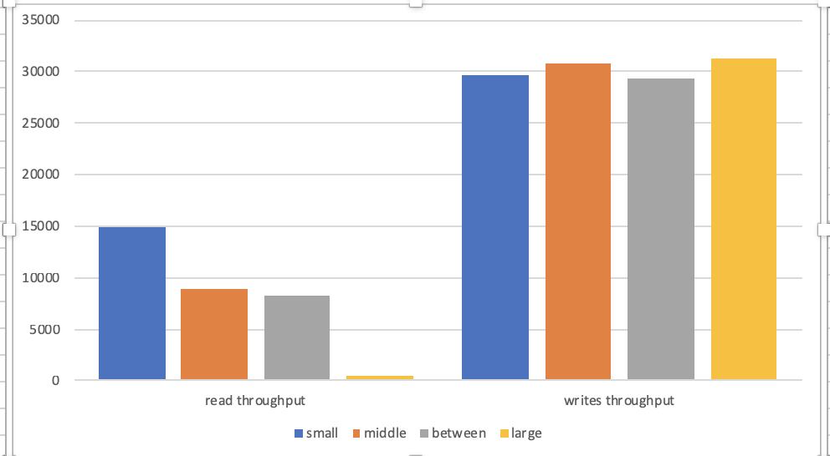
DIFFERENT CONFIGURATION IN RANDOM R/W

Slide 25
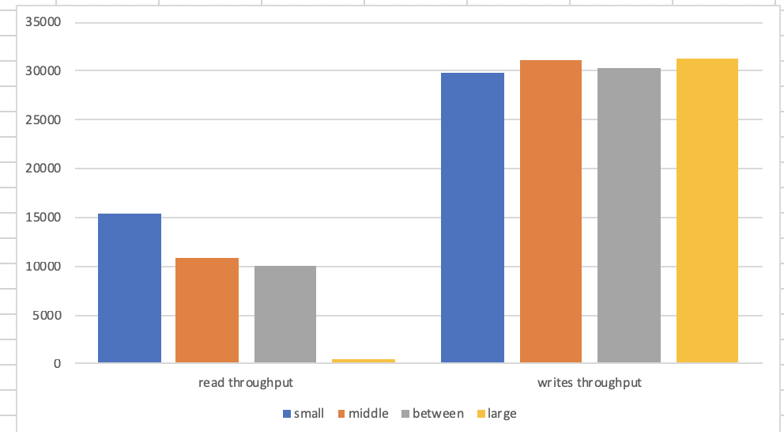
DIFFERENT CONFIGURATIONS IN SEQUENTIAL R/W

Slide 26


Issues and Ongoing Implementation:
Intel open storage tool kit.
VSSIM (Only one Operation is there which is installing OS into another OS using QEMU) - We are not working on it since it has limited operations.
Eagle Tree (Able to run the config file and set the SSD parameters to get the results.)
Notes:
Java version 7
Code Error
Less performance evaluation

Slide 27
Conclusion
We have gone through many applications which can be used to simulate or check the performance of SSD
We have explored most of the factors affecting the performance of SSD.
Notes:
We ran through many tools for SSD's and focused on Intel Open Storage Toolkit since it was implemented in our key paper.

Slide 28
REFERENCES
http://www.csc.lsu.edu/~fchen/publications/papers/sigmetrics09.pdf
http://greg.porter.name/wiki/HowTo:iometer
http://bit.csc.lsu.edu/~fchen/publications/papers/hpca11.pdf
http://ieeexplore.ieee.org/document/7056865/
https://sourceforge.net/projects/intel-iscsi/
https://www.openhub.net/p/intel-iscsi
http://www.iometer.org/

Slide 29


